Slide 1
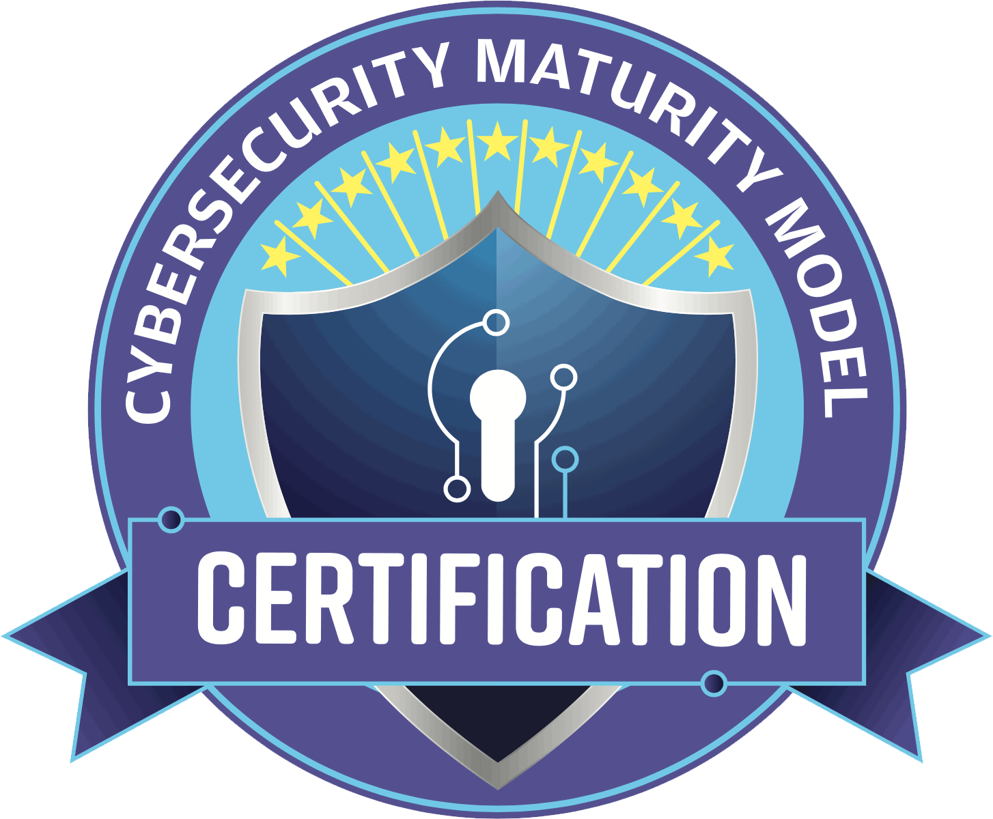
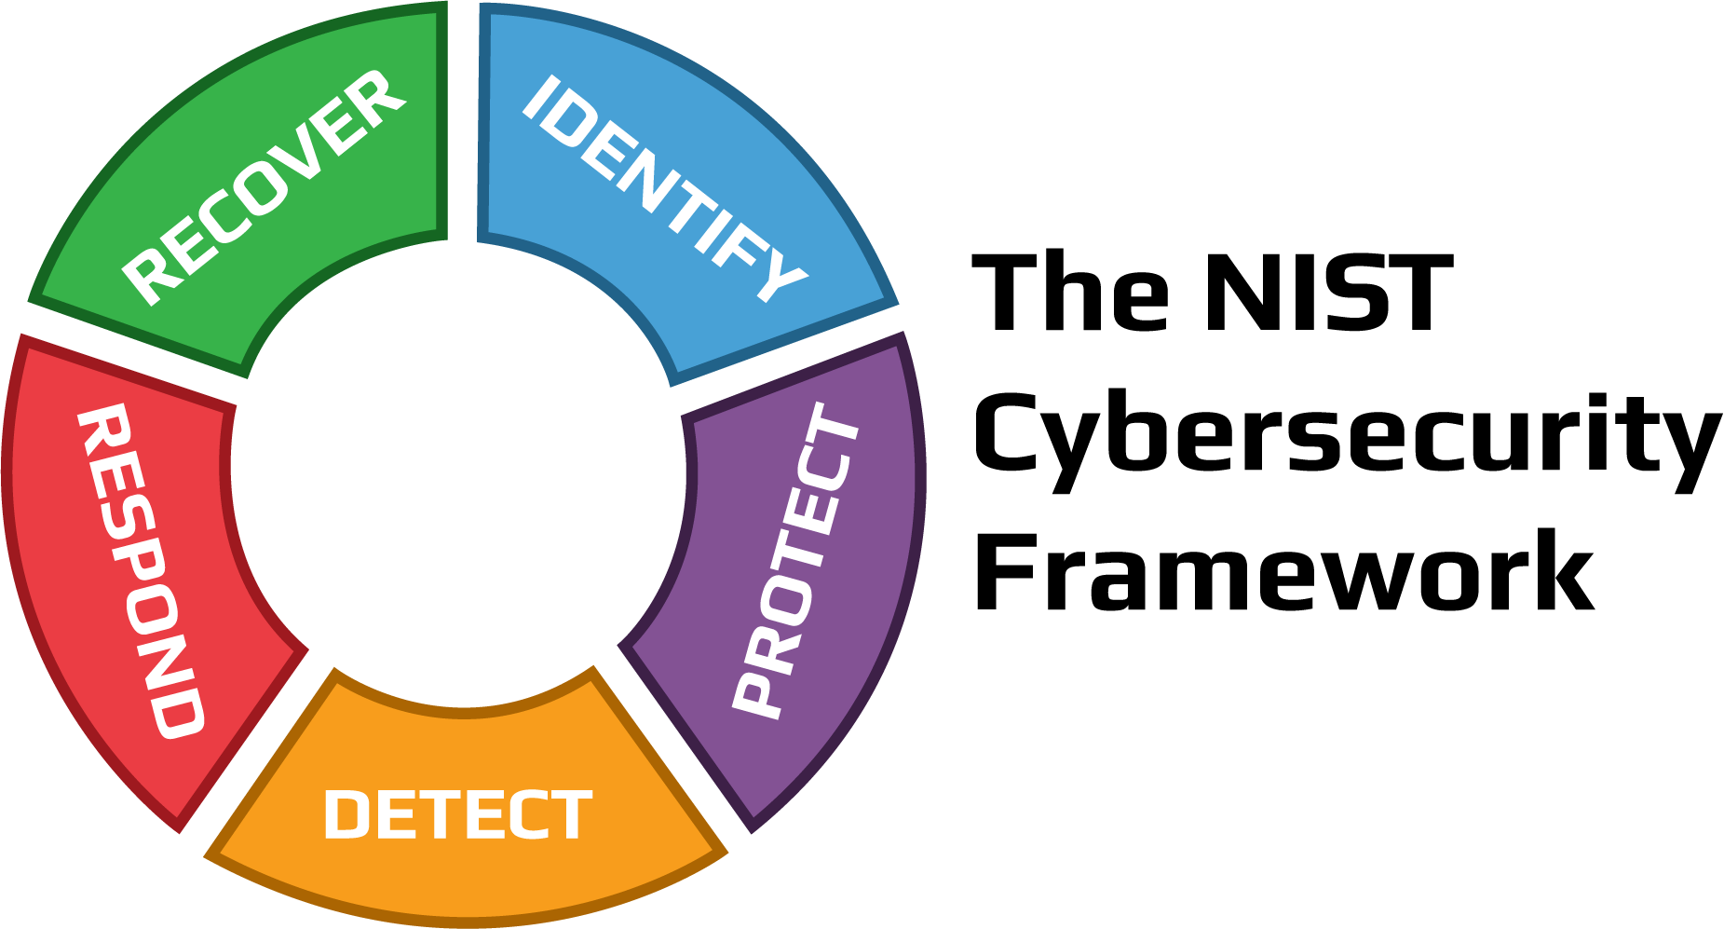
CMMC and NIST
Global Frameworks for Protecting Against Cyber-attacks
1
By Anthony Zatika
CMMC-logo. ITG Consulting. (n.d.). Retrieved June 2, 2022, from https://consulting.itgonline.com/cmmc-news/cmmc-v1-model-published/attachment/cmmc-logo/
Custom managed cybersecurity services in CT. Kyber Security. (2021, August 17). Retrieved June 2, 2022, from https://kybersecure.com/
Notes:
Hello, welcome to my presentation. I will be presenting on CMMC and NIST: the global framework for protecting against cyber-attacks.

Slide 2








Agenda
What is CMMC?
CMMC 1.0 vs CMMC 2.0
What is NIST?
NIST Framework
Questions & Concerns
Notes:
In today’s presentation, I want to address, what is CMMC, (Cybersecurity Maturity Model Certification) and what is NIST, (National Institute of Standards Technology). I will compare CMMC 1.0 vs CMMC 2.0 and I will explain the NIST framework. Finally, I will conclude the presentation with questions and concerns that I have with the frameworks.

Slide 3


Introduction to CMMC 1.0
CMMC refers to the Cybersecurity Maturity Model Certification.
CMMC was first devised into five categories: Level 1, Level 2, Level 3, Level 4, and Level 5.
Introduced on November 25, 2020.
Standard Security Model for DIB (Defense Industrial Base).
Notes:
So, what is CMMC 1.0? CMMC 1.0 is an assessment framework that increases compliance and trust when dealing with CUI (Controlled Unclassified Information). CMMC was first introduced on November 25, 2020, with five levels of security, from basic to advanced, Level 1, 2, 3, 4, 5. The main goal of CMMC 1.0 was to establish a standard security model for the DIB (Defense Industrial Base). Each level was designed to incorporate more (NIST) standards to protect companies or contractors managing CUI.

Slide 4

CMMC 1.0 Levels
Level 1 was based on FAR 52.204-21
Level 2 was created by CMMC
Level 3 was based on NIST SP 800-171
Level 4 was created by CMMC
Level 5 was based on NIST SP 800-172
Notes:
As you can see, the CMMC levels were designed to accumulate more and more NIST standard controls as the levels increased. The reason there are more NIST controls pertains to the maturity factor of the model. Simply, as companies and contractors expand, dealing with more customers and information, unboundedly they will encounter more CUI because they will have more information that they need to keep safe. Therefore, in order to protect that data, there needs to be more mandated controls in place to ensure that the CUI is protected.

Slide 5
CMMC 2.0 Levels
CMMC 2.0 is a three-tiered model.
01
CMMC 2.0 implemented an assessment requirement change.
02
CMMC 2.0 Harmonized with 32-CFR and implemented requirements via RFI.
03
Notes:
** Raise Squares ** Now, in CMMC 2.0, which was released in November of 2021, there was a radical shift in the tiered-levels that change the way NIST standards are implemented. CMMC only requires three levels. Three levels still creates a high level of security while cutting down costs to implement. In 2.0 assessments were also changed, Level 1 only requires a self-assessment because this level is noncritical. In Level two, it requires another self-assessment for non-critical CUI, but a DIB (Defense Industrial Base) tri-annual assessment for critical CUI. Additionally, in Level three, which is all critical CUI, it now requires a tri-annual DIB assessment. In 2.0 other standards such as 32-CFR integrate completely when used together.

Slide 6
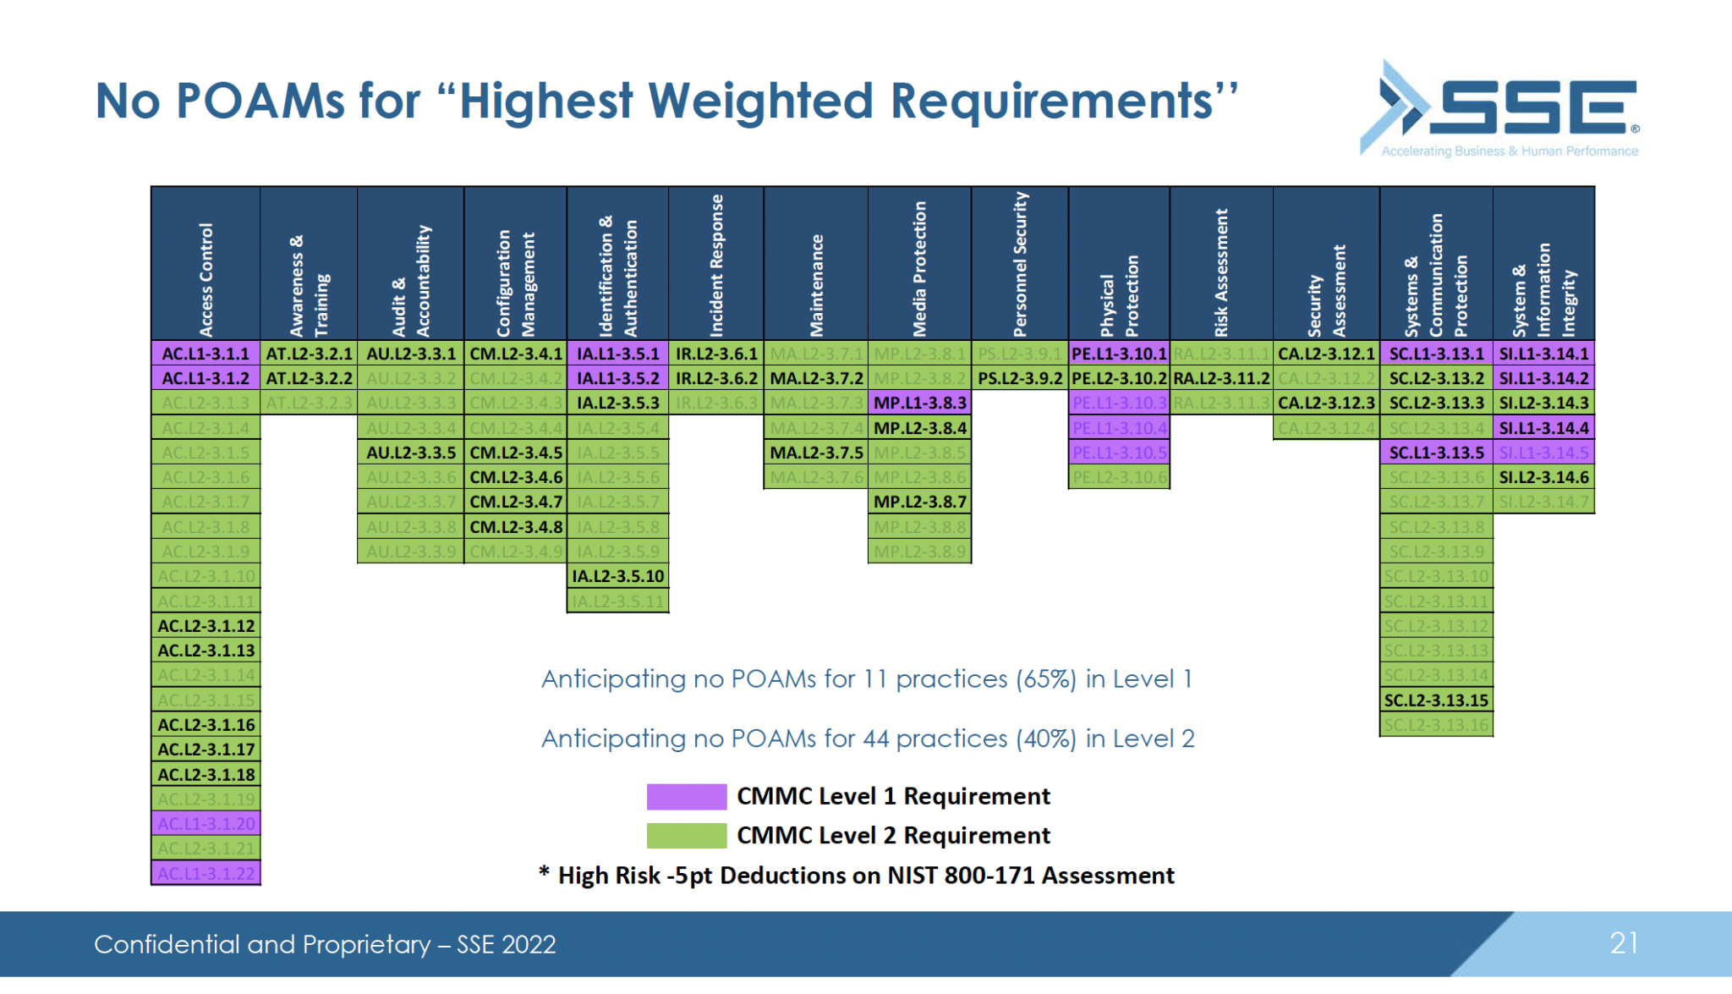
CMMC 2.0 POAM
Businesses will need to deliver on the promises that they make in reference to their security.
The highest (five-point) controls can’t be implemented in a POAM.
What is a Poam?: SSE. (2022, February 23). Retrieved June 1, 2022, from https://www.sseinc.com/blog/what-is-a-poam/
Notes:
Perhaps one of the most important impactful changes in CMMC 2.0 is the POAM, more specifically, the “Plans of Action and Milestones.” This is a list that is required if a company/DoD contractor cannot implement the CUI controls all at once. A POAM should be completely implemented in 180 days or less. This means that businesses/DoD contractors will need to deliver on their security promises. As seen above in the diagram, the highlighted controls are the minimum requirement, each one is worth 5 points. When a company/DoD contractor drafts a POAM, the highest valued security controls need to be implemented immediately, well before the 180 days deadline. This is a mandatory minimum requirement that must initially be met otherwise a company is not NIST compliant. This is to ensure that non-critical and critical CUI is protected right out of the gate.

Slide 7
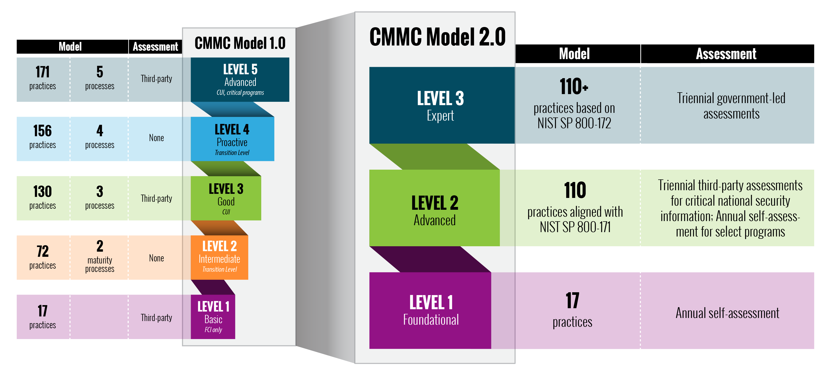
Before
CMMC Comparison
CMMC 1.0 had five levels.
Levels 2 and 4 were virtually unused.
Assessments were conducted through a third party.
There were maturity processes.
The gap of rules from level 1 to level 2 was huge.
7
This list reveals specifically what has changed from CMMC 1.0 to CMMC 2.0
After
CMMC 2.0 has three levels.
Levels 2 and 4 were erased.
Assessments are conducted through the government or via self-assessment.
There are no maturity processes.
The overload of rules from level one to level two still exist.
Criticality has not been mentioned.
Webmaster, O. U. S. D. A. S. (n.d.). Securing the defense industrial base. Retrieved June 1, 2022, from https://www.acq.osd.mil/cmmc/
Notes:
Here, we see the CMMC Comparison of 1.0 and 2.0. CMMC 1.0 has more levels of NIST compliant controls. There are five levels vs the three in 2.0. However, there are levels of these five levels of maturity that may not be necessary. For instance, through my research, levels 2 and 4 were virtually unused. This is because companies/DoD contractors only needed to use level 1 or level 3 to comply if they had CUI. There wasn’t an incentive to implement any more CUI controls due to the cost or not many fell under the criticality requirements of 2 and 4. CMMC 1.0 required that all assessments were completed by a third party. In CMMC 2.0, assessments were completed by the government or their own company/DoD contractor department. One similarity between CMMC 1.0 and CMMC 2.0 that has not changed is that from level 1 to level 2, there are too many controls required. Also, one stunning fact is that in 2.0, the definition of criticality has not been defined. This means that companies are not exactly sure which category they fall into without corresponding with CMMC/Department of Defense directly.

Slide 8
CMMC 2.0 Attempts to Improve CMMC 1.0 by:
“Cutting red tape” (www.summit7.us).
“Setting priorities for protecting DoD Information” (www.summit7.us).
“Reinforcing cooperation between DoD and industries to address cyber-attacks” (www.summit7.us).
Reinventing a, “comprehensive framework to protect the defense industrial base from increasingly frequent and complex cyber-attacks” (www.summit7.us).
Notes:
Looking at the bullet points above demonstrate that CMMC 2.0 is an improvement over1.0. First, companies/DoD contractors will have to deal with less red tape by either completing assessments through their own departments or through the government, instead of a third-party company. Second, it sets priorities and protects DoD information through having defined criticality levels. Third, 2.0 reinforces more cooperation between companies/DoD contractors with the Department of Defense through 2.0’s global standard. Lastly, 2.0 reinvented a comprehensive framework to include more controls that help protect the DIB from cyber-attacks. Now, let’s take a step back and review NIST.

Slide 9

Introduction to:
Access Control
Awareness and Training
Audit and Accountability
Configuration Management
Identification and Authentication
Incident Response
Matienance
Media Protection
Physical Protection
Risk Assessment
Security Assessment
System and Communications Protection
Personnel Security
System and Information
Notes:
Stepping away from CMMC, we can talk about some of the core requirements that are implemented in the CMMC model by NIST. There are 14 extensive sections that are chocked full of rules and regulation pertaining to critical and non-critical CUI. For example, some notable security controls are, “3.1.19 Encrypt CUI on mobile devices and mobile computing platforms,” “3.4.8 Apply deny-by-exception (blacklisting) or deny-all, permit-by-exception (whitelisting) policy to allow the execution of authorized software,” and even “3.13.8 Implement cryptographic mechanisms to prevent unauthorized disclosure of CUI…” I can go on and on because there are over 900 of them. They are all essential though because these security controls aim to protect the integrity of CUI that companies are handling through encrypting internal company message traffic. Most importantly, the purpose of having these over 900 security controls is to make attacking a company/DoD contractor painfully difficult.

Slide 10
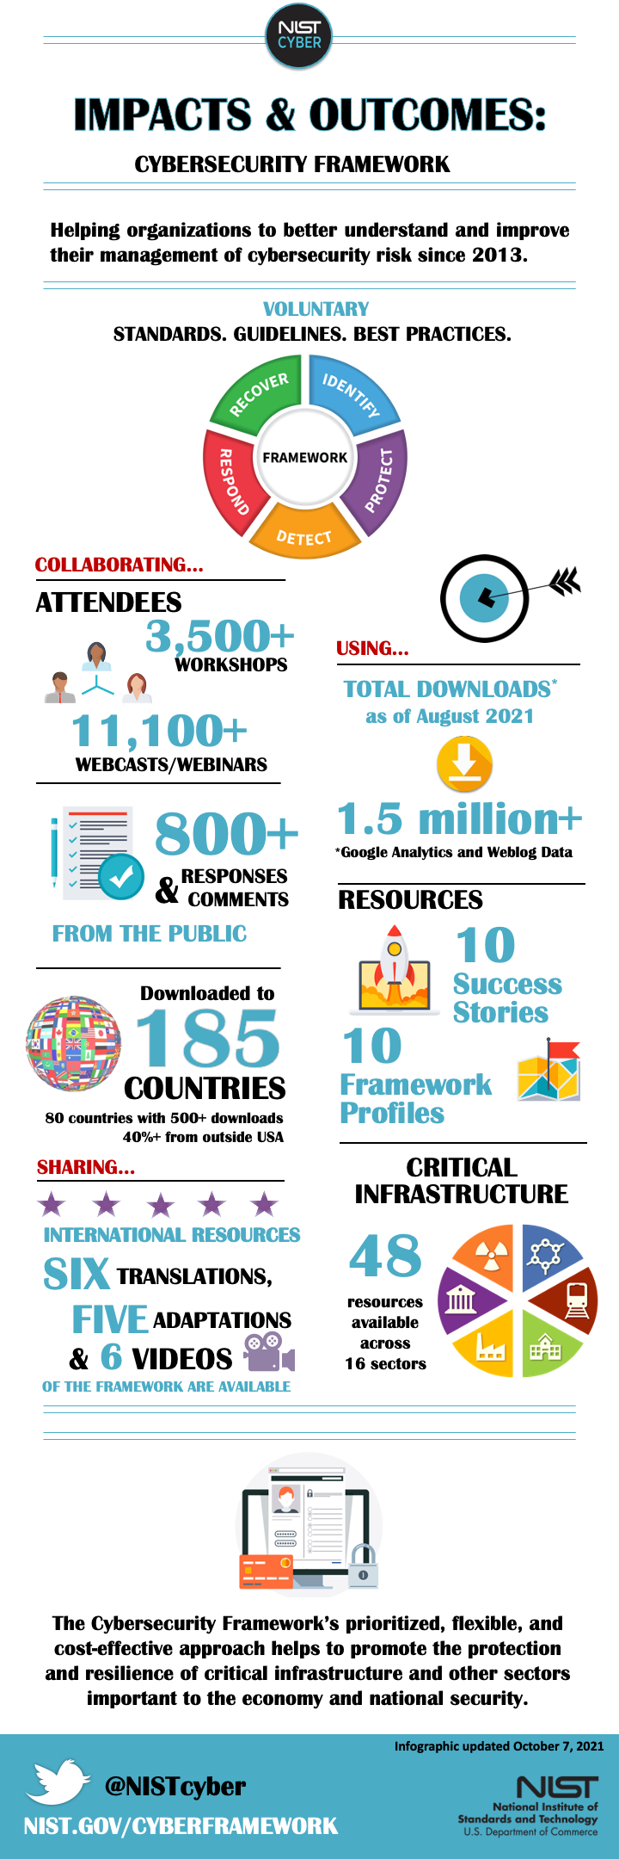
NIST Framework
The NIST Framework has 5 categories sworn to defend and recover from cyberattacks.
The NIST framework is a flexible and reliable standard.
Nicole.keller@nist.gov. (2022, May 26). Infographic. Retrieved June 1, 2022, from https://www.nist.gov/cyberframework/infographic
Notes:
Every CUI Control of the 900 in NIST is categorized into five categories: identify, protect, detect, respond, and recover. The NIST framework is shared with more than “80 countries” (Keller, 2022), demonstrating that it is the default worldwide agreeable standard for protecting CUI.

Slide 11

Summary
In summary, while CMMC 2.0 and NIST provide companies and DoD contractors with exceptional CUI controls, they are expensive to implement.
There are still headaches when referencing CUI controls: there are too many.
CMMC 2.0 has fixed the issues of not being an adoption standard.
CMMC 2.0 and NIST harmonize together.
Notes:
As I wrap up this presentation, I wanted to summarize all the points that I have presented today. While CMMC 2.0 provides companies/DoD contractors with an execution plan to become NIST/CMMC compliant, they are inherently expensive with too many controls. On the other hand, CMMC 2.0 is by far better than CMMC 1.0. in that CMMC 2.0 appears to clean up the messy levels 2 and 4 by discarding them. CMMC 2.0 also finally is an agreed upon standard and that NIST, CMMC, and other standards harmonize together. CMMC 2.0 also reinforces much needed cooperation between companies/DoD contractors with the Department of Defensed through having mutual acknowledgement of the framework. There are, however, just some unanswered/concerning questions.

Slide 12

Questions and Concerns
I am unable to shake the feeling that CMMC 2.0 will be expensive.
How might a time limit of 180 days affect POAM’s?
How many rules in NIST again!?!
In CMMC 2.0, is there a determining factor for criticality?
About the Author: Dr. Kasters Staff. (2018, April 9). Are you suffering with a mystery headache that will not go away? Retrieved June 1, 2022, from https://drkasters.com/chiropractic-blog/news/suffering-mystery-headache-will-not-go-away/
Notes:
I am unable to shake the feeling that CMMC 2.0 will be just as expensive or even more expensive to implement than CMMC 1.0. Although CMMC 2.0 have decreased the CUI levels model from five to three, in hopes of eliminating the cost of implementing too many CUI controls, a POAM will still be required to implement the other non-critical CUI controls. Since POAMs are required to be completed in 180 days or less, this, of course, means that the cost may be more has not been eliminated and it may be that more money may be required to implement the non-critical CUI controls. Levels three and two from CMMC 1.0 were combined into level two in CMMC 2.0 Levels four and five in CMMC 1.0 were combined into level three in CMMC 2.0. Therefore, there will be more required CUI controls than before. On the other hand, what makes this certification process so much worse is the over 900 rules in NIST. Companies/DoD contractors will ultimately implement a soup of CUI controls that do not pertain to their security level. It would have been better to completely throw away the CUI requirements from levels two and four instead of combining them together. Moreover, in CMMC 2.0 criticality requirements have not been addressed. This poses the question on how companies/DoD contractors are assigning themselves to the 3 levels and whether this would mean they may have to switch levels if criticality is defined.

Slide 13


Thank you for your time.
Josepha.Zatika@netsafeid.com
Notes:
Well, that is it! Hope you enjoyed my presentation. If any of you have any questions or have and new insights, please let me know!

Slide 14

References
(2019). Retrieved June 1, 2022, from https://www.youtube.com/watch?v=51kcOCUJXlo.
(2022). Retrieved June 1, 2022, from https://www.youtube.com/watch?v=8ueHPCXR-pQ.
22, E. N. • D. (2021, December 22). CMMC 2.0: POA&M requirement changes. Retrieved June 1, 2022, from https://cybersheath.com/cmmc-2-0-poam-requirement-changes/
About the Author: Dr. Kasters Staff. (2018, April 9). Are you suffering with a mystery headache that will not go away? Retrieved June 1, 2022, from https://drkasters.com/chiropractic-blog/news/suffering-mystery-headache-will-not-go-away/
Armond, A. (2021, November 9). CMMC 2.0 is here - what changes in CMMC? Retrieved June 1, 2022, from https://www.cmmcaudit.org/cmmc-2-0-is-here-what-changes-in-cmmc/
CMMC 2.0 Compliance: Defense Industrial Base. CMMC 2.0 Compliance | Defense Industrial Base. (n.d.). Retrieved June 2, 2022, from https://www.summit7.us/cmmc-2.0-dib
CMMC-logo. ITG Consulting. (n.d.). Retrieved June 2, 2022, from https://consulting.itgonline.com/cmmc-news/cmmc-v1-model-published/attachment/cmmc-logo/
Custom managed cybersecurity services in CT. Kyber Security. (2021, August 17). Retrieved June 2, 2022, from https://kybersecure.com/
Inc., 24B. S. (n.d.). Cybersecurity & Compliance Specialists. Retrieved June 1, 2022, from https://www.24by7security.com/
National Institute of Standards and Technology. (2022, May 23). Retrieved June 1, 2022, from https://www.nist.gov/
Nicole.keller@nist.gov. (2022, May 26). Infographic. Retrieved June 1, 2022, from https://www.nist.gov/cyberframework/infographic
Webmaster, O. U. S. D. A. S. (n.d.). Securing the defense industrial base. Retrieved June 1, 2022, from https://www.acq.osd.mil/cmmc/
What is a Poam?: SSE. (2022, February 23). Retrieved June 1, 2022, from https://www.sseinc.com/blog/what-is-a-poam/
Notes:
Here is my reference sheet.

